Slide 1




Hospital Management System
Final Group Project Hospital Management System : Group No 57
NANCY TASWALA
ATHARVA KURLEKAR
PRANAV PATEL
Northeastern University | 2024

Slide 2
PROBLEM
1
Healthcare systems face significant challenges in managing diverse operational tasks such as patient care, diagnostics, appointment scheduling, and medicine stock tracking. The absence of an integrated platform often leads to inefficiencies, communication breakdowns, and delayed services. A lack of role-specific systems to address community health, lab diagnostics, IT troubleshooting, and pharmacy administration further exacerbates the problem. These issues hinder the ability of hospitals and healthcare networks to provide effective and timely care.
Northeastern University | 2024

Slide 3

INTRODUCTION
2
The Hospital Management System is a robust software solution designed to streamline hospital operations, ensuring efficient coordination across departments, optimized patient care, and seamless administrative management.
Northeastern University | 2024

Slide 4
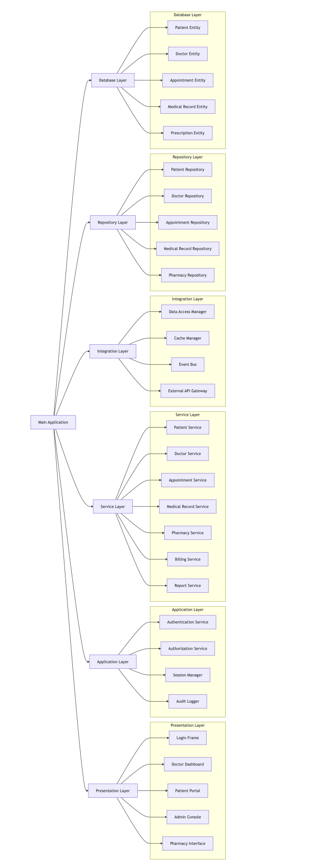
SYSTEM ARCHITECTURE DIAGRAM:
3
Northeastern University | 2024

Slide 5
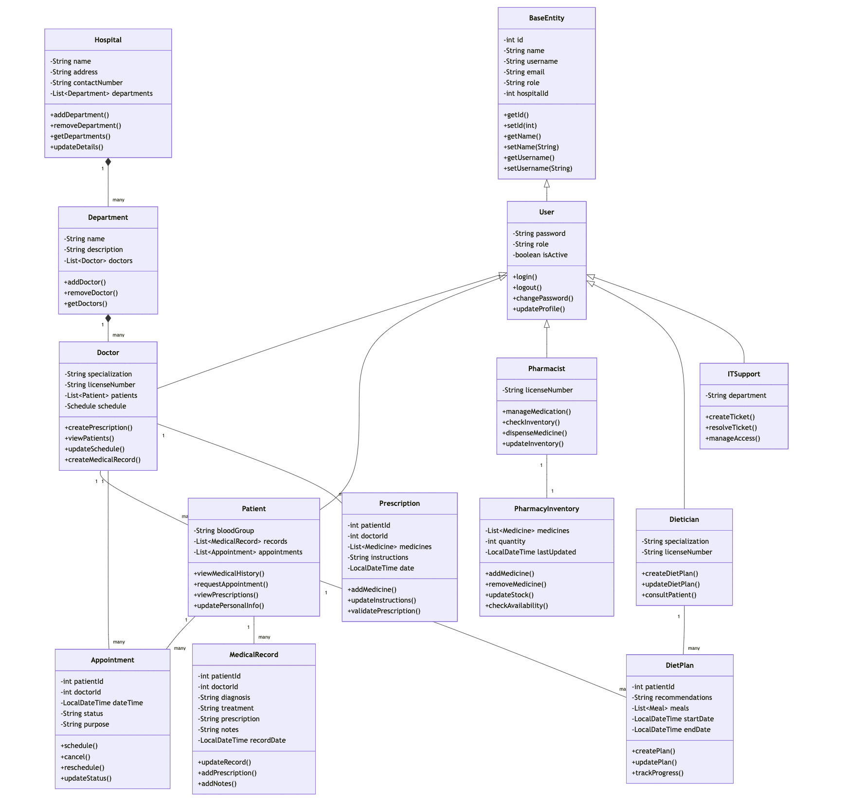
DOMAIN MODEL :
5
Northeastern University | 2024

Slide 6

KEY SYSTEM CAPABILITIES:
8
1. User Role Management
Tailored interfaces for different roles (Doctors, Patients,IT support, Pharmacy).
Role-based access control ensuring secure, appropriate access to sensitive information.
2. Authentication & Authorization
Secure login using AuthenticationService.
Role-based access managed by the AuthorizationService to ensure the right level of access for each user.
Northeastern University | 2024

Slide 7
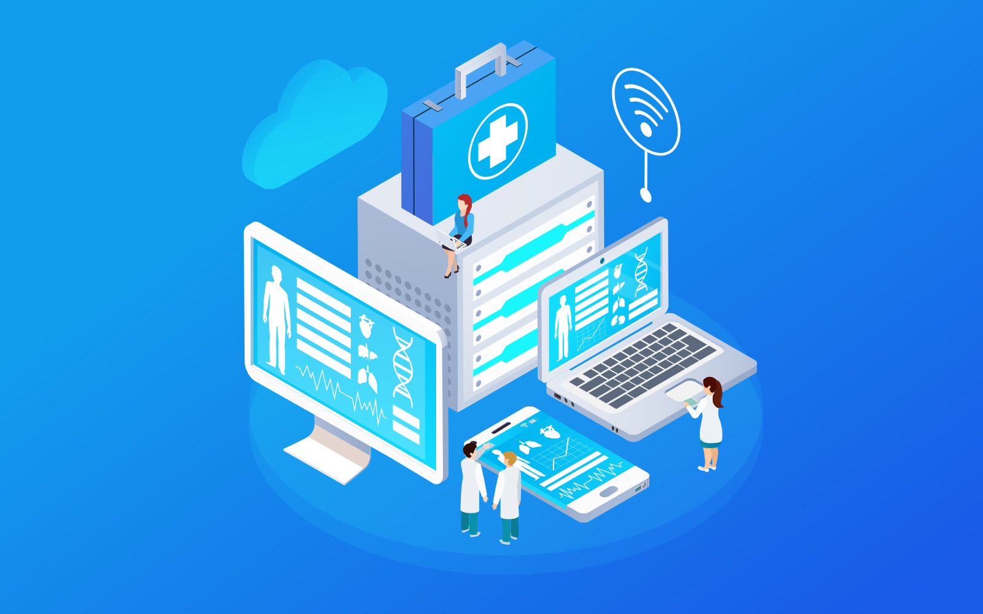
SYSTEM CAPABILITIES:
3. Comprehensive Business Logic
Patient management: Registration, records, appointments.
Doctor management: Appointment scheduling, medical history.
Pharmacy: Prescription management and inventory control.
4. Data Handling & Persistence
Repository layer for secure and consistent data management Patient, Doctor, Appointment, Medical Records.
Optimized for scalability and data integrity.
5. Real-Time Reporting & Audit
Audit Logger tracks system activities for compliance and transparency.
Reporting service for generating insights on patient trends, billing, and inventory.
Northeastern University | 2024

Slide 8
9
POTENTIAL IMPACT
Potential Impact
Improved Patient Care: By streamlining patient registration, appointments, and medical records, the system ensures faster and more accurate healthcare delivery.
Increased Operational Efficiency: Automation of administrative tasks such as billing, inventory management, and report generation frees up resources for more critical tasks.
Enhanced Security and Compliance: With robust authentication, authorization, and audit logging, the system ensures patient data privacy and regulatory compliance.
Real-Time Decision Making: The reporting and analytics features allow for immediate insights into hospital operations, enabling better decision-making and resource allocation.
Northeastern University | 2024

Slide 9

CONCLUSION
11
The Hospital Management System offers a robust, scalable solution to streamline operations, enhance security, and improve user experience. With role-based access, secure authentication, and comprehensive data handling, it ensures efficient management of patient care, appointments, and pharmacy services. Its real-time reporting and audit features enable informed decision-making and compliance with healthcare standards, making it a powerful tool for modern healthcare institutions.
Northeastern University | 2024

Slide 10
THANK YOU
Northeastern University | 2024

